Slide 1
Lightning Talk
By: Andrew Peters, John Smolinski, James Eenhuis, Geng Sun, and Dheepak Nalluri

Slide 2
Technical Goals
Design Overview
Design architecture defined
Individual systems defined
Prototyped individual systems
Review of systems and design
Finalize system and design
Task generation and division

Slide 3
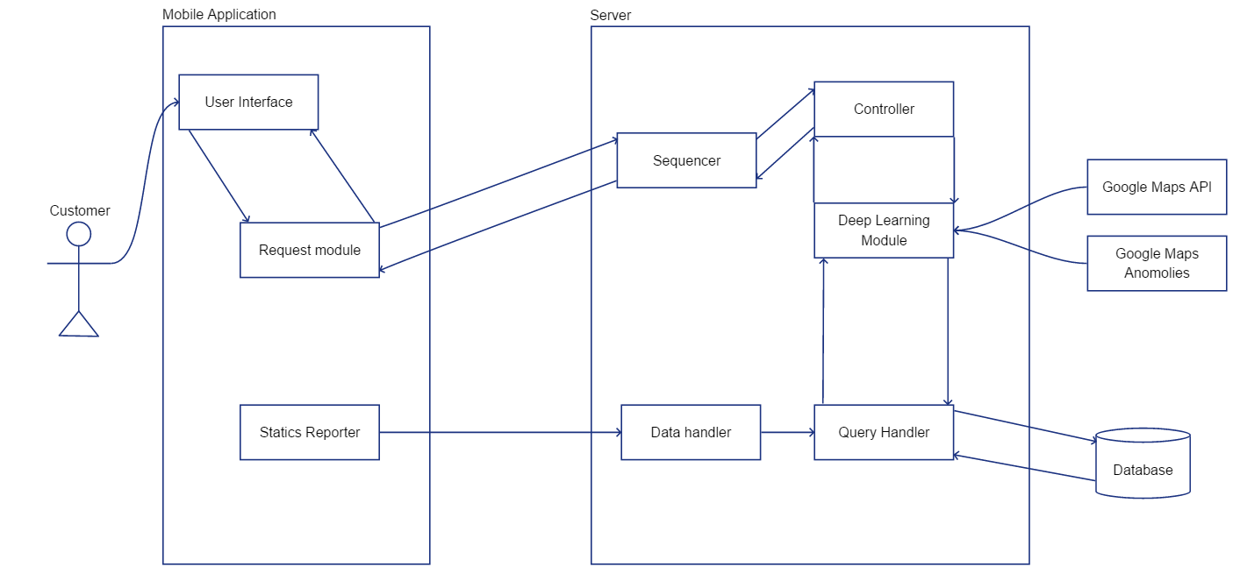
Prototype System Overview

Slide 4
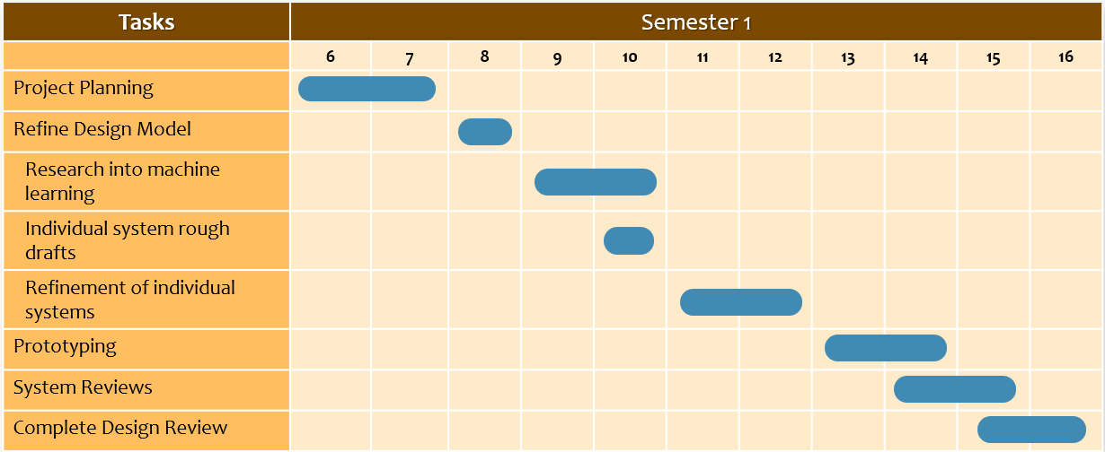
Semester 1 Schedule

Slide 5
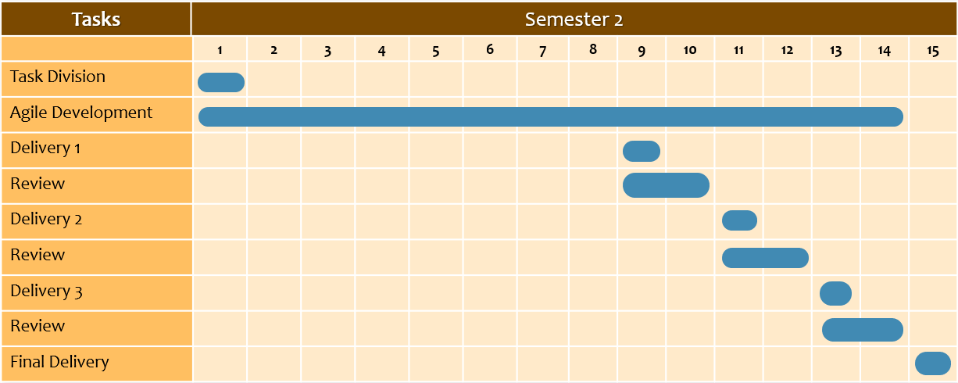
Semester 2 Schedule

